Slide 1
Day 5-
Sending Numbers
Code.org- Unit 1, Lesson 6

Slide 2
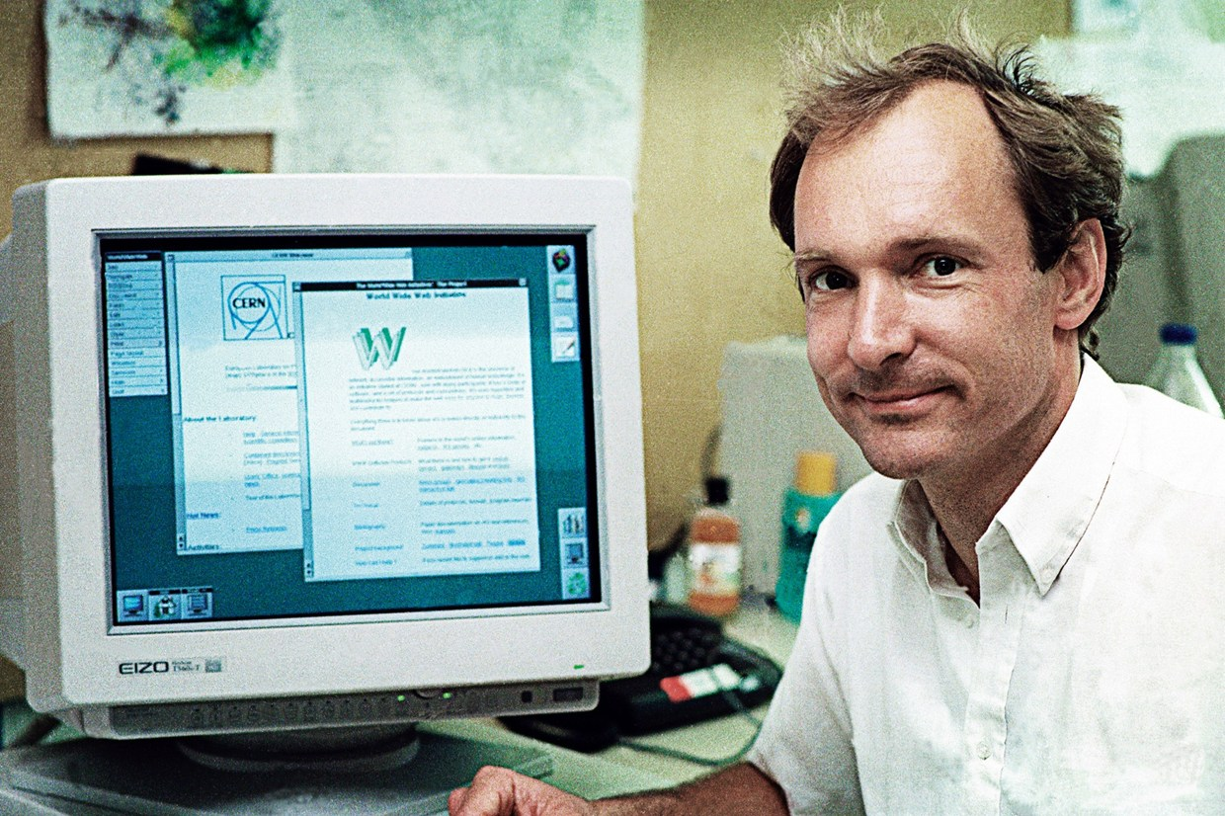
Tim Berners Lee
Who is this guy?

Slide 3
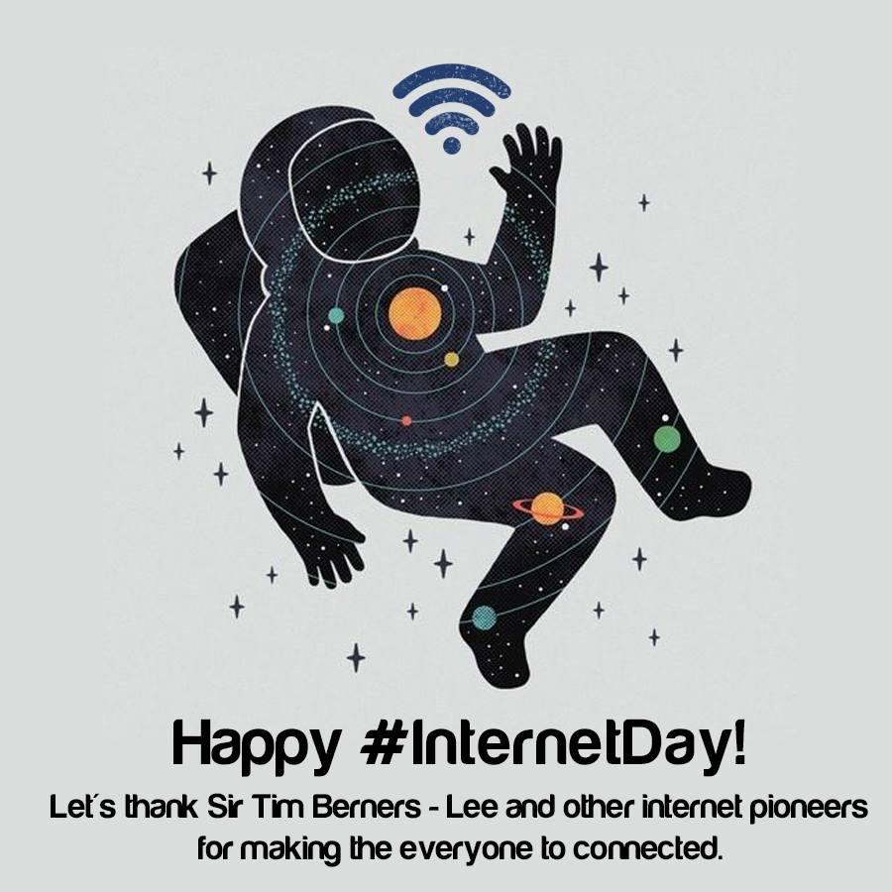
Happy birthday World wide web
Tim Berners Lee- Creator
27th anniversary!
August 1991
Help Physicists Collaborate
1st Ever Webpage
Open Source- Royalty-Free in Perpetuity

Slide 4
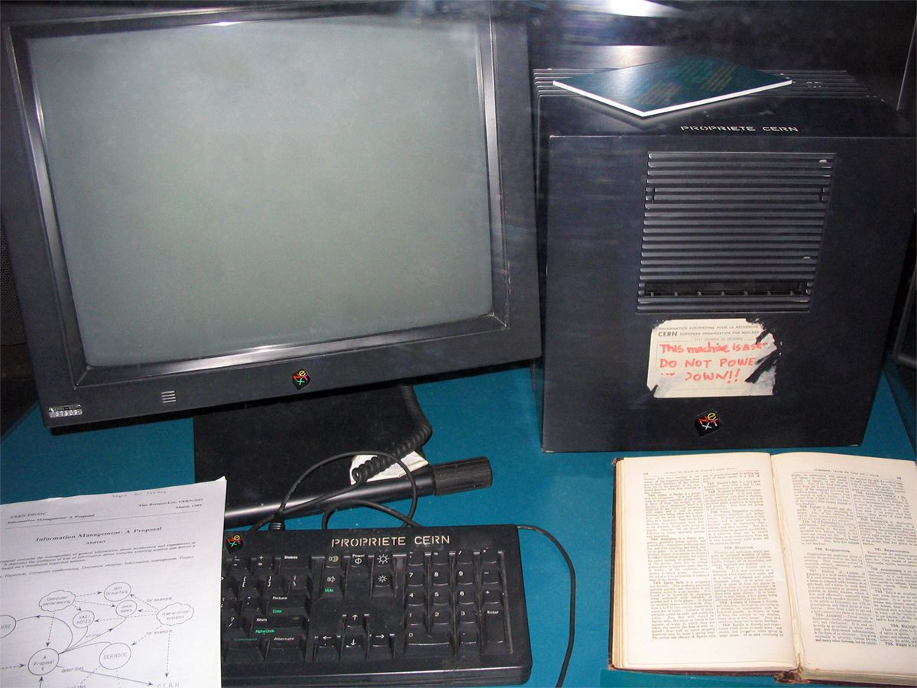
NEXT Computer- "The Cube“
1st Web Server
It was launched in 1988 at a cost of $6,500 each
The NeXT Computer was not a significant commercial success, failing to reach the level of high volume sales like the Apple II, Commodore 64, the Macintosh, or Microsoft Windows PCs.

Slide 5

Journal Check
End of the Week

Slide 6
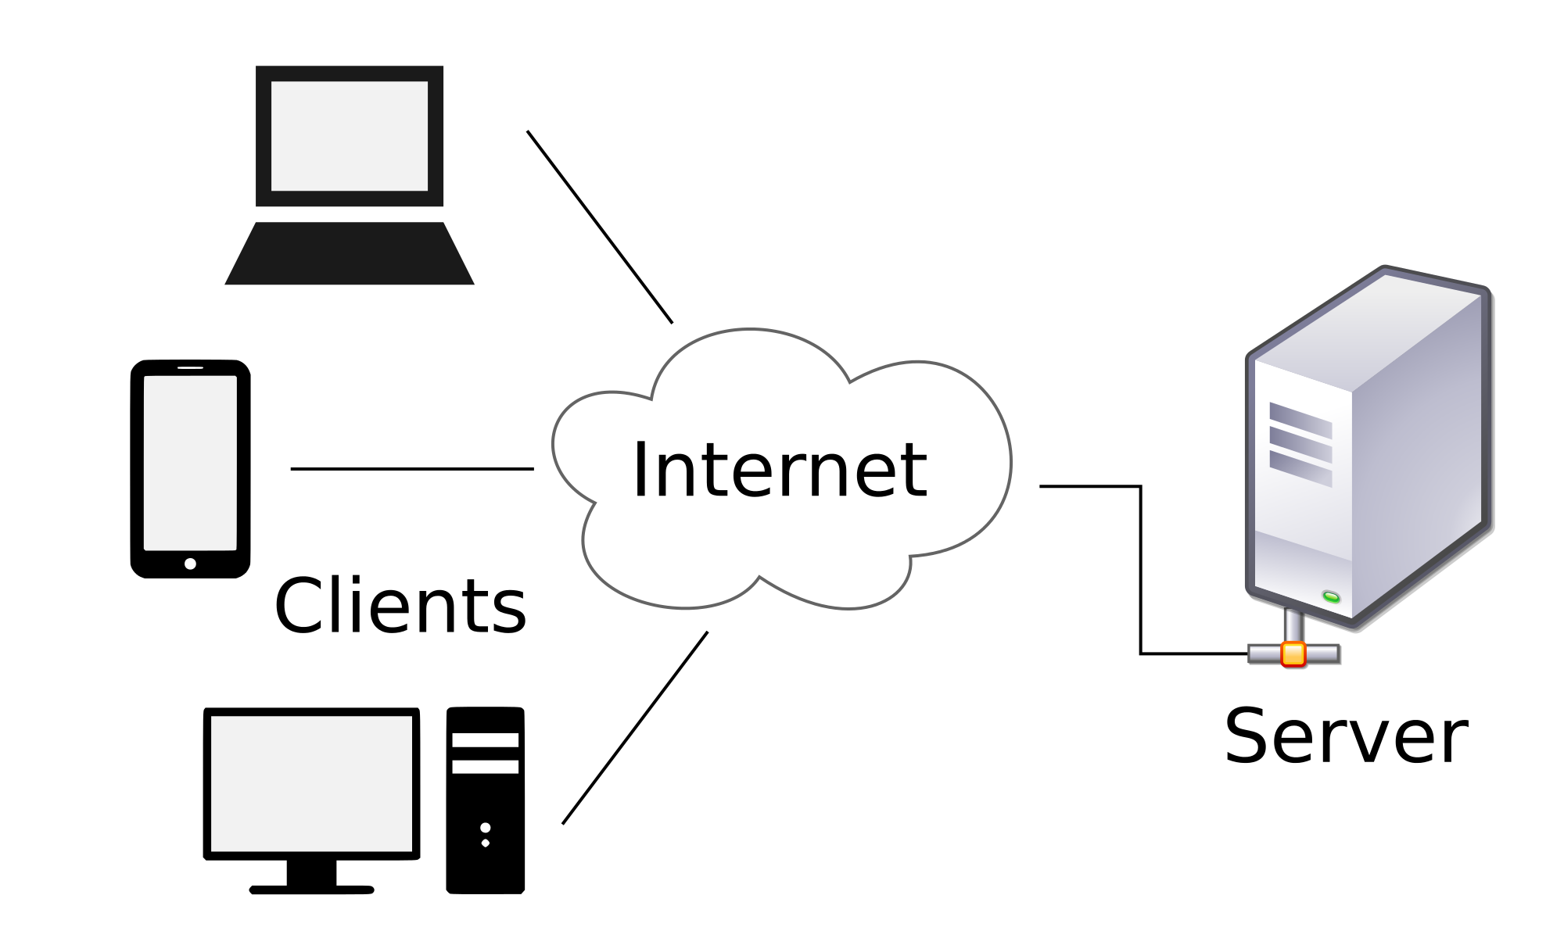
Binary Code Counting Quiz
5 Points
--Write in Bytes (8 Digits)--
Question 1- Binary to Decimal
Question 2- Binary to Decimal
Question 3- Binary to Decimal
Question 4- Decimal to Binary
Question 5- Decimal to Binary

Slide 7
Protocols- Agreements
All communication protocols solve the problem of how to send (binary encoded) information from one place to another. This requires that the sender and receiver agree on how many bits form a proper message and how big the "chunks" of bits should be.
In this lesson you will use the Internet Simulator to send a simple line drawing to a classmate encoded in binary. The drawing will be encoded as coordinates on a grid to connect lines. You must develop a protocol for sending a list of numbers to your partner over the internet simulator.

Slide 8
Internet Simulator (Lesson 6 Style)
“Your job is to explore this tool with a partner - click all the buttons, type in the text areas what you can. You cannot break it so don’t worry.“
“What’s different now? There is a bit of a mystery in what the tool does…and doesn’t do. Can you figure it out?“
“You and your partner have 5-10 minutes to poke around and see what you can find.”
Watch Video About New Simulator

Slide 9

Sending Numbers Activity
Sending Numbers Activity Instructions
Sending Numbers for Graphing Worksheet
Complete Activity
Try Another Groups Protocol

Slide 10
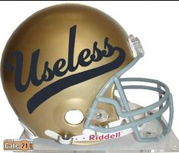
The End
Review Today’s Activity
Finish Lesson 1-6 at Code.org (Will Look For Completion End of Week)
Journal Entry Reminders

